Slide 1
C
CALIMAN ADVISORY SRL
Turning data into insights.
Driving performance.
MANAGEMENT REPORT
Year-to-Date
January - April 2026
Actual versus budget, with prior-year comparison, capital expenditure and full-year outlook. Prepared in July 2026 using the Power BI semantic model.
Synthetic data · portfolio project.
Does not describe any real entity.
PERIOD
BASIS
1 Jan - 30 Apr 2026
Actual vs Budget · PY 2025
CURRENCY
EXTRACTED
EUR · thousands unless stated
8 July 2026

Slide 2
EXECUTIVE SUMMARY
Back to profit: four months of real growth, budget requires revision
€36,9M
€7,1M
€3,0M
€5,6M
NET REVENUE
EBITDA
NET INCOME
FREE CASH FLOW
+121,8% vs budget
19,2% margin
+245,8% vs PY
OpCF €5,7M
Revenue more than doubled the budget in every single month and grew 100.8% year over year. EBITDA turned positive - €7.1M against a budgeted loss - continuing the recovery that started in 2025 after two loss-making years. Net income grew 245.8% to €3.0M.
Caution: the budget baseline is unusually conservative (implies a full-year EBITDA loss), and accounts receivable grew €27.7M against €36.9M of revenue - a real cash-conversion watch item despite the profit turn.
Caliman Advisory | Executive Financial Review | Synthetic data, portfolio project
2

Slide 3
INCOME STATEMENT
YTD April 2026, actual versus budget
€ THOUSANDS | ACTUAL | BUDGET | VAR | VAR %
Net Revenue | 36.900 | 16.637 | 20.263 | +121,8%
Total COGS | 15.846 | 17.737 | (1.891) | -10,7%
Gross Profit | 21.054 | (1.099) | 22.153 | +2.014,9%
Total OPEX | 13.975 | 6.744 | 7.231 | +107,2%
EBITDA | 7.079 | (7.843) | 14.922 | +190,3%
D&A | 3.253 | 265 | 2.988 | +1.127,4%
EBIT | 3.826 | (8.108) | 11.934 | +147,2%
Financial Result Net | 3.203 | (7) | 3.210 | n.m.
EBT | 7.028 | (8.115) | 15.144 | +186,6%
Income Taxes | 4.028 | 622 | 3.406 | +547,7%
Net Income | 3.000 | (8.737) | 11.737 | +134,3%
Key Takeaways
A €14.9M EBITDA beat against budget carries through to an €11.7M net income beat: D&A (-€3.0M) and taxes (-€3.4M) absorb part of the gap, while the financial result (+€3.2M) supports it. COGS came in favorable even as revenue doubled - worth validating account mapping before the next close. OPEX ran €7.2M over budget, absorbing about a third of the revenue upside.
Caliman Advisory | Executive Financial Review | Synthetic data, portfolio project
3

Slide 4
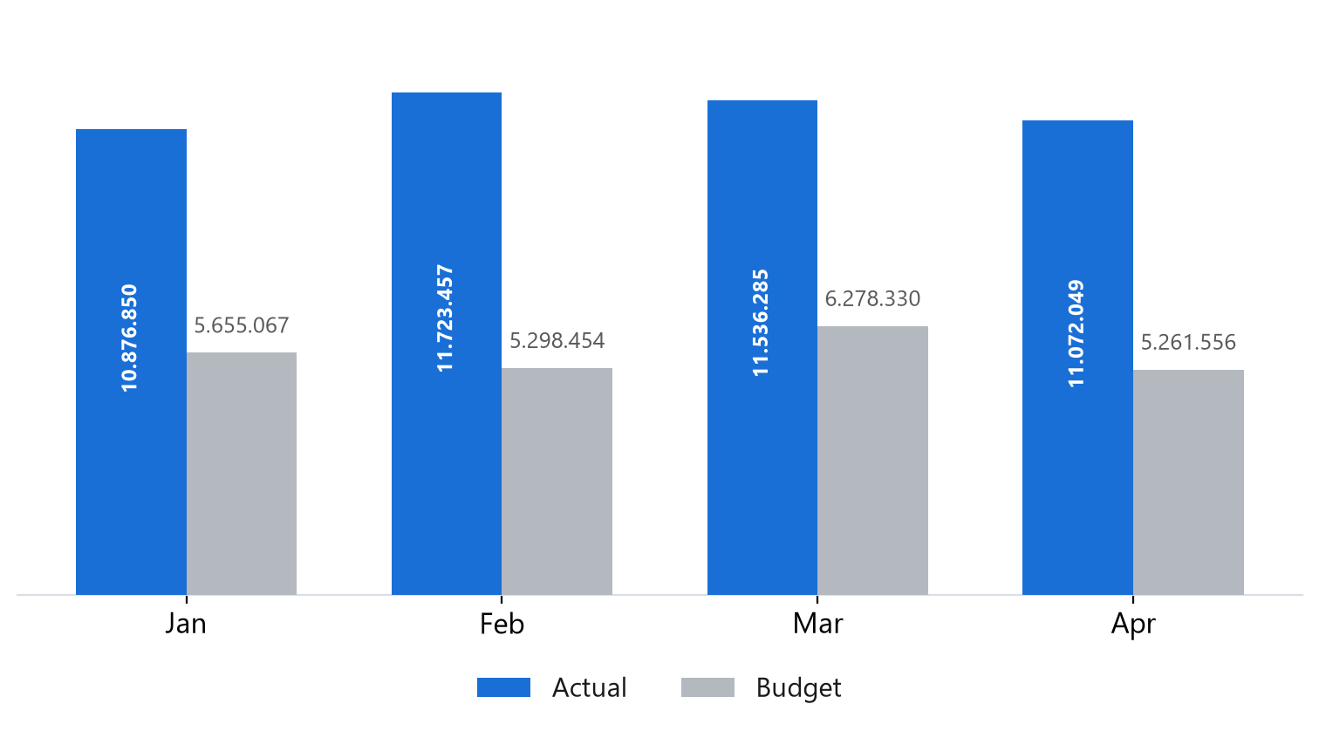
VARIANCE ANALYSIS
Revenue was approximately twice budget, every month
+20.263
YTD VARIANCE (€K)
+121,8% vs budget
Monthly actuals sit in a narrow €10.9-11.7M band on gross revenue. Nothing about the pattern suggests a timing effect - the budget was simply set well below the run rate the business had already reached in 2025.
Caliman Advisory | Executive Financial Review | Synthetic data, portfolio project
4

Slide 5
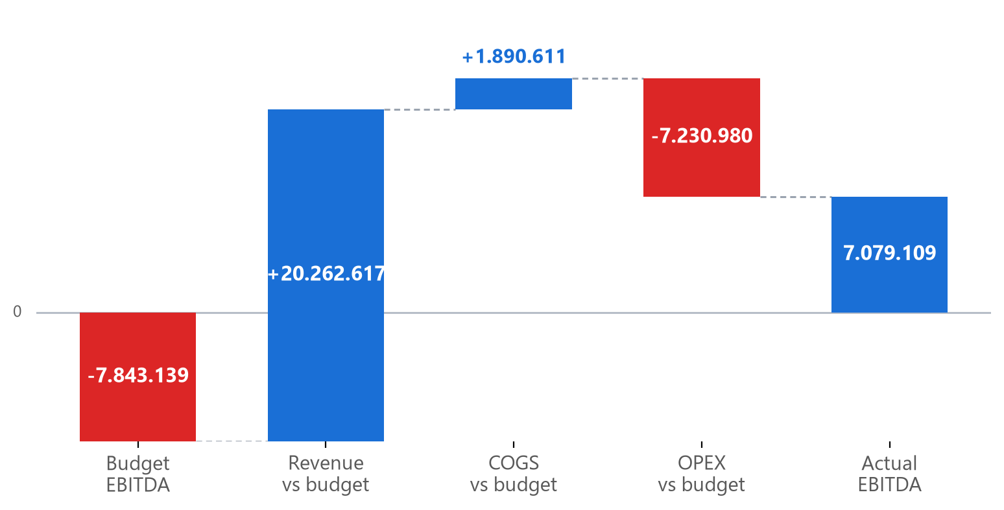
VARIANCE ANALYSIS
EBITDA bridge: budget to actual
€ thousands. Bars float on the running EBITDA total, so a step can cross zero; the label is that step's own change, not its endpoint. Revenue explains most of the gap; OPEX gives back about a third.
Caliman Advisory | Executive Financial Review | Synthetic data, portfolio project
5

Slide 6
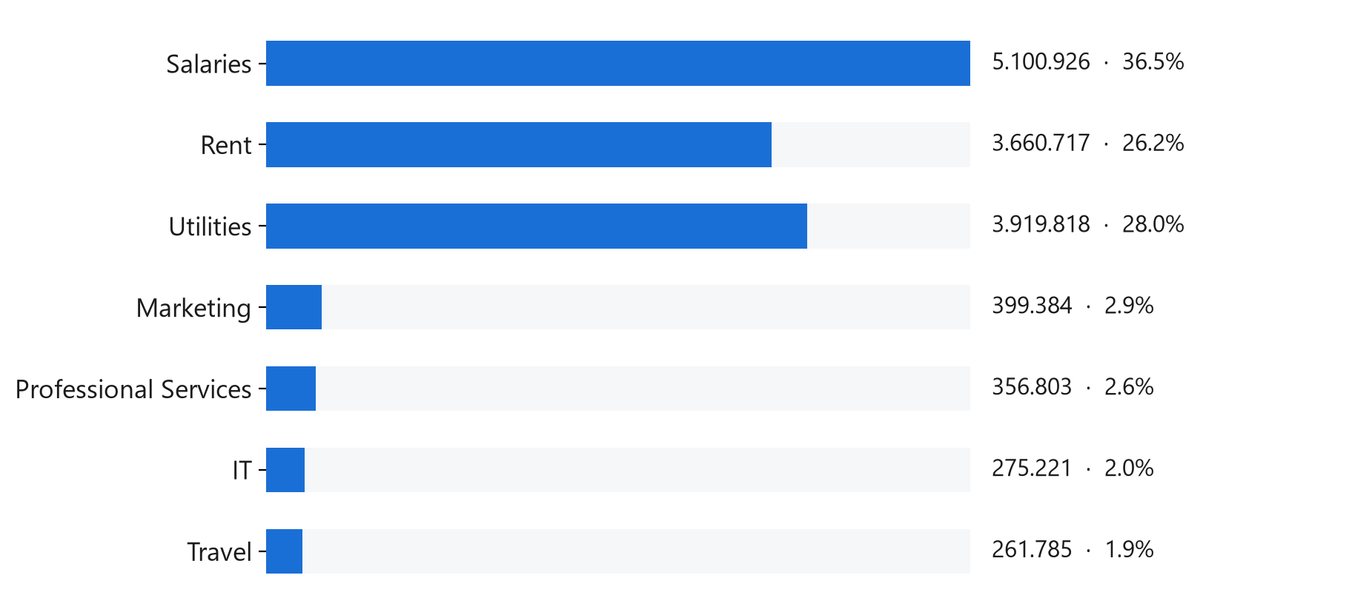
VARIANCE ANALYSIS
OPEX grew with activity, €7.2M over plan
OPEX held at 37,9% of revenue - broadly in line with activity. Salaries, rent and utilities make up 91% of total OPEX. Rent and utilities are normally semi-fixed and should not scale with volume the way they have here. Action: investigate rent and utilities postings.
Caliman Advisory | Executive Financial Review | Synthetic data, portfolio project
6

Slide 7
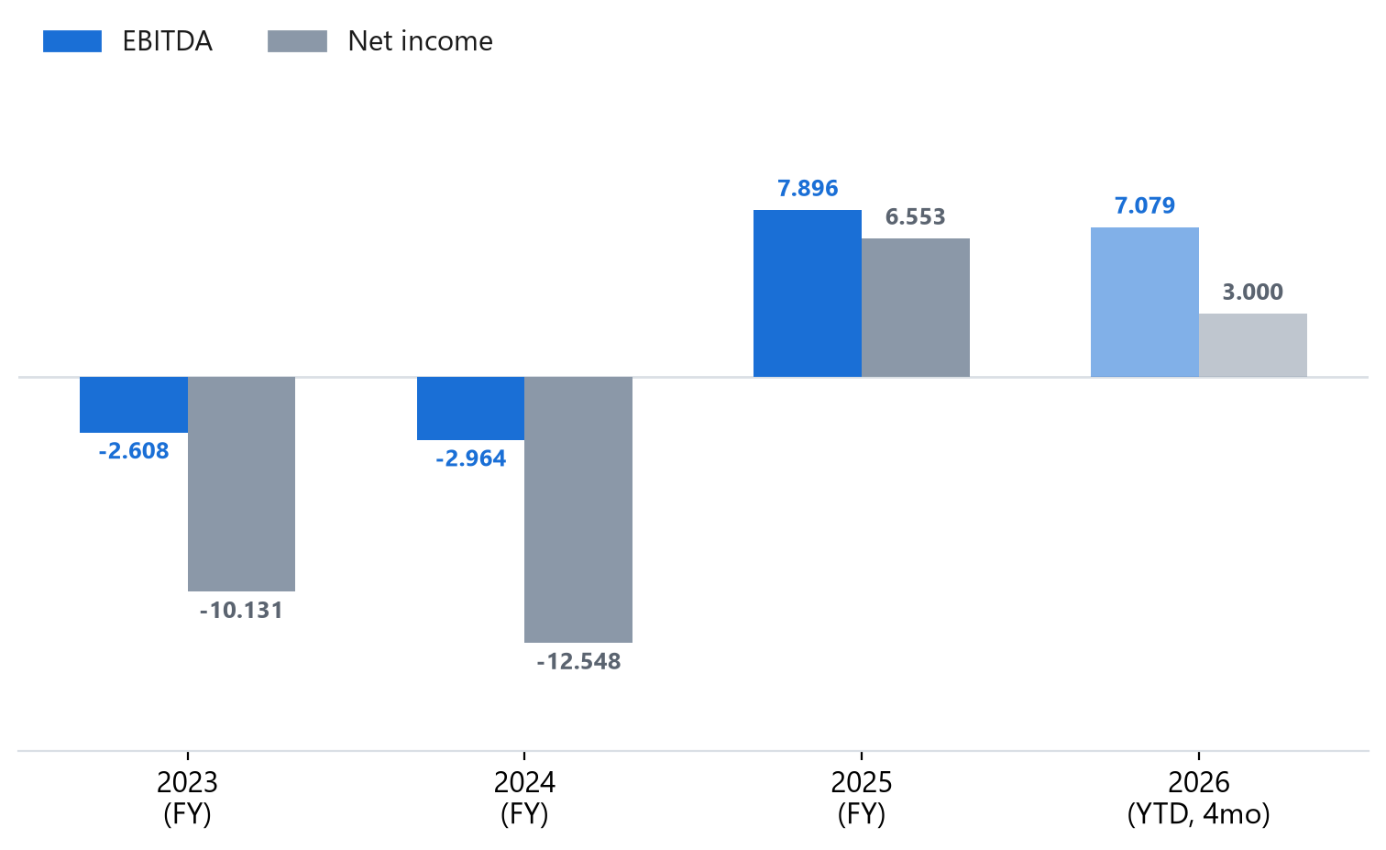
PRIOR-YEAR COMPARISON
Loss-to-profit turnaround, now continuing into 2026
+100,8%
REVENUE
+470,1%
EBITDA
+245,8%
NET INCOME
2023 and 2024 were loss-making years; 2025 was the turnaround. The first four months of 2026 are already 46% of all of 2025's profit.
Caliman Advisory | Executive Financial Review | Synthetic data, portfolio project
7

Slide 8
BALANCE SHEET
Sound position, one anomaly and one watch item
€ THOUSANDS | 30 APR 26 | 31 DEC 25 | CHANGE
Cash & equivalents | 1.623 | 1.675 | (53)
Accounts receivable | 48.685 | 21.000 | 27.685
Inventory (!) | (7.868) | 8.000 | (15.868)
Prepaid expenses | 280 | 280 | 0
Current assets | 42.720 | 30.955 | 11.764
Non-current assets | 54.691 | 54.800 | (109)
Total assets | 97.410 | 85.755 | 11.655
Total liabilities | 41.198 | 38.054 | 3.144
Equity | 56.212 | 47.702 | 8.511
1.59
CURRENT RATIO
from 1.31, improved
0.73
DEBT TO EQUITY
from 0.80, improved
(!) Inventory is negative in the ledger at Apr 2026 (was positive at year-end 2025) - a genuine data anomaly, shown at true sign rather than masked. AR nearly doubled - the key cash-conversion watch item.
Caliman Advisory | Executive Financial Review | Synthetic data, portfolio project
8

Slide 9
CASH FLOW
Operations funded growth during the period
€ THOUSANDS | YTD APR 2026
Net income | 3.000
D&A (non-cash add-back) | 3.253
Working capital & other | (586)
Cash flow from operations | 5.667
Investing activities | (100)
Financing activities | (238)
Net cash movement | 5.330
Free cash flow | 5.567
Operating cash flow of €5,7M comfortably exceeds net income of €3,0M on the strength of the depreciation add-back. Investing activity was minimal; financing flows were near zero. Growth this period is largely self-funded from operations. Note: the cash flow statement is internally consistent, but its closing cash does not currently tie to the balance sheet cash line - a €3.8M gap between two calculation paths in the model, logged for correction.
Caliman Advisory | Executive Financial Review | Synthetic data, portfolio project
9

Slide 10
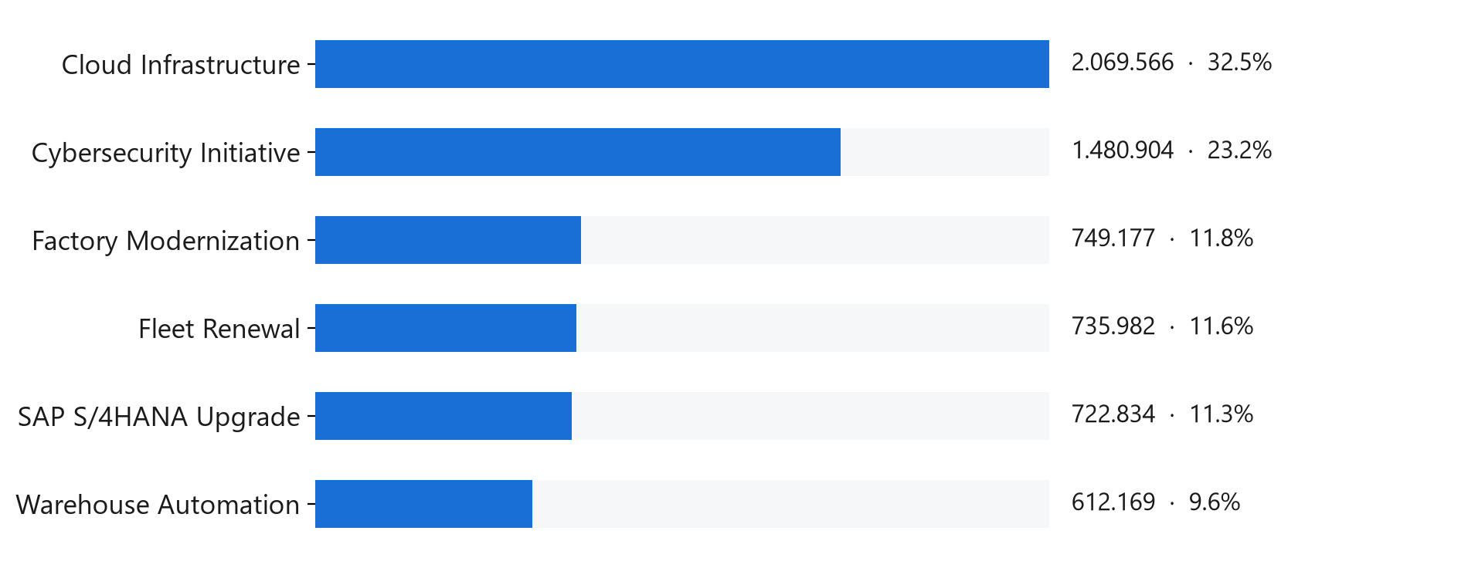
CAPITAL EXPENDITURE
2025 program complete; nothing committed yet in 2026
€6,4M
2025 PROGRAM
six projects
Cloud infrastructure and cybersecurity absorbed 55.7% of the 2025 program, consistent with the shift toward hosted delivery. No new capex committed in 2026 through April - investing outflows are minimal against a €3.3M depreciation charge, so the asset base is being consumed faster than renewed.
Caliman Advisory | Executive Financial Review | Synthetic data, portfolio project
10

Slide 11
BASIS & OPEN DATA QUALITY ITEMS
Three items to know before relying on individual lines
01 NEGATIVE INVENTORY
-€7.9M at 30 Apr 2026 (positive at YE2025). A posting error, shown at true sign, not masked.
02 CASH CROSS-STATEMENT TIE
Balance sheet cash €1.6M vs cash flow closing cash €5.4M - a €3.8M gap between two calculation paths.
03 DSO/DPO EXCLUDED
Standalone measures don't yet respect the date filter in every context; excluded pending a fix.
Caliman Advisory SRL | Executive Financial Review | Synthetic data, portfolio project | Prepared July 2026

